Slide 1
BRAZILLIAN E-COMMERCE SITE - OLIST
Olist Store

Slide 2
Group 3:
Group Members
Asad Karel
Atul Gaikwad
Harshil Roy
Praveen Kamath
Sugandh Srivastava

Slide 3
What is OList
The largest department store in Brazilian marketplaces.
Olist connects small businesses from all over Brazil to channels without hassle and with a single contract. Those merchants are able to sell their products through the Olist Store and ship them directly to the customers using Olist logistics partners.
This is a Brazilian ecommerce public dataset of orders made at Olist Store.
The dataset has information of 100k orders from 2016 to 2018 made at multiple marketplaces in Brazil. Its features allow viewing an order from multiple dimensions: from order status, price, payment and freight performance to customer location, product attributes and finally reviews written by customers. It also includes a geolocation dataset that relates Brazilian zip codes to latitude and longitude coordinates.

Slide 4

Data Schema of Olist Store

Slide 5

What are we predicting? - ‘Customer Churn’
Customer Churn Category can either be 1 or 0:
1 => Customer Churned
(those who did not purchase any product in the last Six Months)
0 => Customer Not Churned
(otherwise)

Slide 6
And Why are we predicting ?
It’s more cost effective to retain existing customers than to acquire new ones, which is why it’s important to track customers at high risk of turnover (churn) and target them with retention strategies .

Slide 7
Scope & Limitation of Project
Scope:
As per Kaggle, given dataset is the subset of the actual data.
The dataset has data of year 2016,2017 & 2018.
Limitation:
Multi-lingual data.
The analysis is based on the given the data.

Slide 8
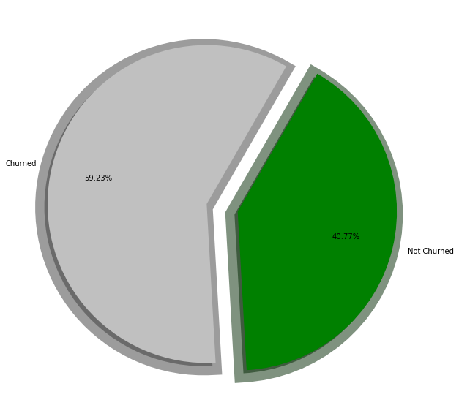
Proportion of Churned and Non-Churned Customers.
Almost 60% of the customers are churned.

Slide 9
Data Dictionary

Slide 10
1. Customer Dataset (olist_customers_dataset.csv):
This dataset has information about the customer and its location. Use it to identify unique customers in the orders dataset and to find the orders delivery location.
customer_id : It is key to the orders dataset. Each order has a unique customer_id.
customer_unique_id:unique identifier of a customer.
customer_zip_code_prefix:First five digits of customer zip code.
customer_city : Customer city name.
customer_state : State of Customer.

Slide 11
2. Geolocation Dataset (olist_geolocation_dataset.csv):
This dataset has information Brazilian zip codes and its lat/lng coordinates.
geolocation_zip_code_prefix : First 5 digits of zip code.
geolocation_lat: Latitude
geolocation_lng: Longitude
geolocation_city: The city name.
geolocation_state: The state name.

Slide 12
3. Order Items Dataset (olist_order_items_dataset.csv):
This dataset includes data about the items purchased within each order.
order_id:Order unique identifier
order_item_id:Sequential number identifying number of items included in the same order.
product_id:product unique identifier
seller_id:seller unique identifier
shipping_limit_date:Shows the seller shipping limit date for handling the order over to the logistic partner.
price:item price
freight_value:item freight value item (if an order has more than one item the freight value is splitted between items)

Slide 13
4. Payments Dataset (olist_order_payments_dataset.csv):
This dataset includes data about the orders payment options.
order_id:unique identifier of an order.
payment_sequential: a customer may pay an order with more than one payment method. If he does so, a sequence will be created to accommodate all
payment_type:method of payment chosen by the customer.
payment_installments:number of installments chosen by the customer.
payment_value:transaction value.

Slide 14
5. Order Reviews Dataset (olist_order_reviews_dataset.csv):
This dataset includes data about the reviews made by the customers.
After a customer purchases the product from Olist Store a seller gets notified to fulfill that order. Once the customer receives the product, or the estimated delivery date is due, the customer gets a satisfaction survey by email where he can give a note for the purchase experience and write down some comments.
review_id: unique review identifier.
order_id: unique order identifier.
review_score: Note ranging from 1 to 5 given by the customer on a satisfaction survey.
review_comment_title: Comment title from the review left by the customer, in Portuguese.
review_comment_message: Comment message from the review left by the customer, in Portuguese.
review_creation_date: Shows the date in which the satisfaction survey was sent to the customer.
review_answer_timestamp: Shows satisfaction survey answer timestamp.

Slide 15
6. Order Dataset (olist_orders_dataset.csv):
This dataset includes data about the items purchased within each order.
order_id: unique identifier of the order.
customer_id: key to the customer dataset. Each order has a unique customer_id.
order_status: Reference to the order status (delivered, shipped, etc).
order_purchase_timestamp: Shows the purchase timestamp.
order_approved_at: Shows the payment approval timestamp.
order_delivered_carrier_date: Shows the order posting timestamp. When it was handled to the logistic partner.
order_delivered_customer_date: Shows the actual order delivery date to the customer.
order_estimated_delivery_date: Shows the estimated delivery date that was informed to customer at the purchase moment.

Slide 16
7. Products Dataset (olist_products_dataset.csv):
This dataset includes data about the products sold by Olist
product_id: unique product identifier.
product_category_name: root category of product, in Portuguese.
product_name_lenght: number of characters extracted from the product name
product_description_length: number of characters extracted from the product description.
product_photos_qty: number of product published photos.
product_weight_g: product weight measured in grams.
product_length_cm: product length measured in centimeters.
product_height_cm: product height measured in centimeters.
product_width_cm: product width measured in centimeters.

Slide 17
8. Sellers Dataset (olist_sellers_dataset.csv):
This dataset includes data about the sellers that fulfilled orders made at Olist. Use it to find the seller location and to identify which seller fulfilled each product.
seller_id: seller unique identifier
seller_zip_code_prefix: first 5 digits of seller zip code
seller_city: seller city name
seller_state: seller state

Slide 18
9. Category Name Translation (product_category_name_translation.csv):
Translates the productcategoryname to english.
product_category_name: category name in Portuguese
product_category_name_english: category name in English

Slide 19
Data Preprocessing
Approximately 4% of null values
Distribution in categorical and numerical, feature-wise
Null values imputation with group by and mean.
Conversion of ‘DateTime’ datatype conversion. From nanosecond to days.
Product name translation to analyze to match with English name. Categorized all the products into 8 categories.
Dropped all id's columns.
Selected churned/ Non-Churned based on 6 months order placed.
Added Order frequency and overall price feature for each customer.
Added product volume feature by removing length/height/width attributes.
Outliers' treatment - Log transformations

Slide 20
DATA VISUALIZATION

Slide 21
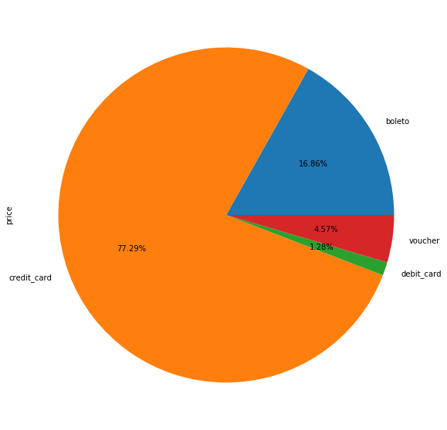
Percentage of Payments Carried Out by Various Modes
A large chunk of customers paid using Credit Cards.

Slide 22
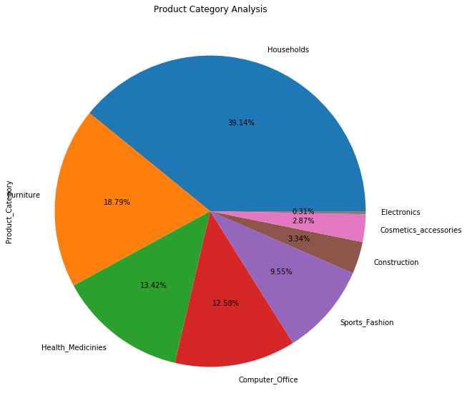
Percentage of Various Product Categories
Household items are essential items hence bought frequently.

Slide 23
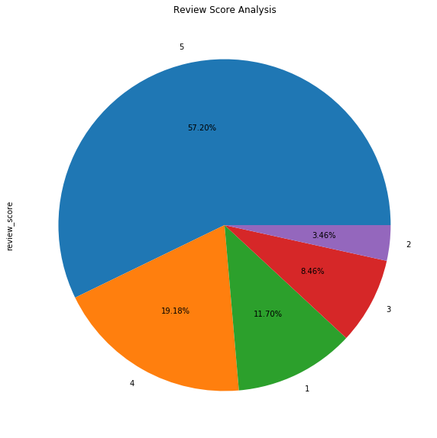
Percentage Of Review Scores From Best To Worst
A large chunk of reviews have remained positive ranging from 4-5 ratings.

Slide 24
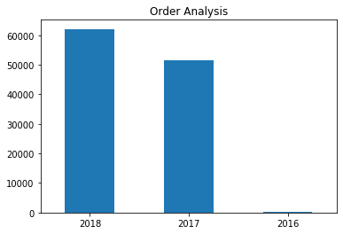
Total Year-wise Order Purchase Volume (2016-2018)

Slide 25
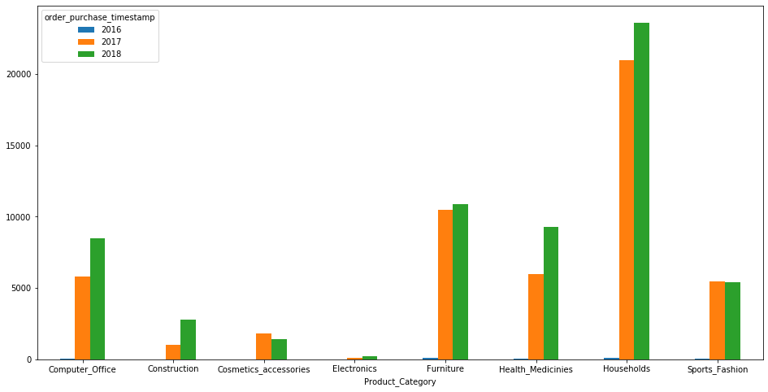
Product-wise Order Purchase Volume (2016-2018)

Slide 26
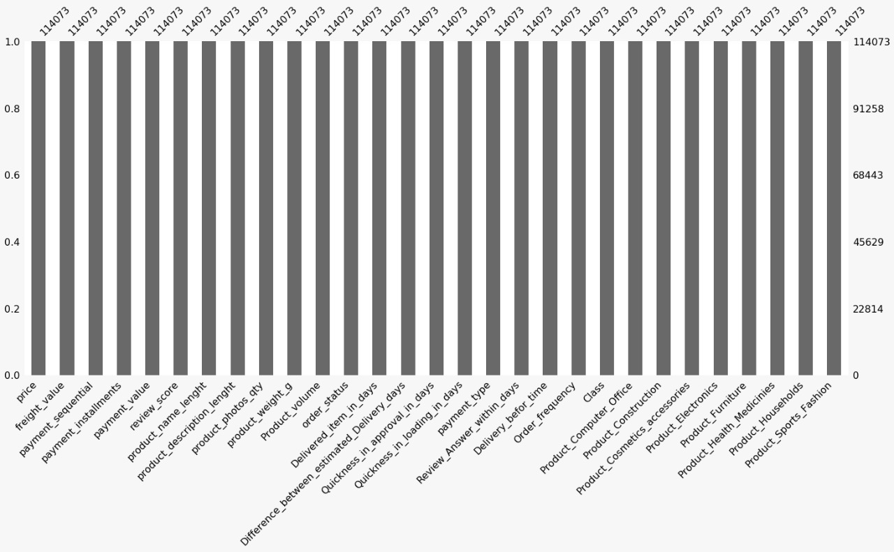
Post Outlier Treatment

Slide 27
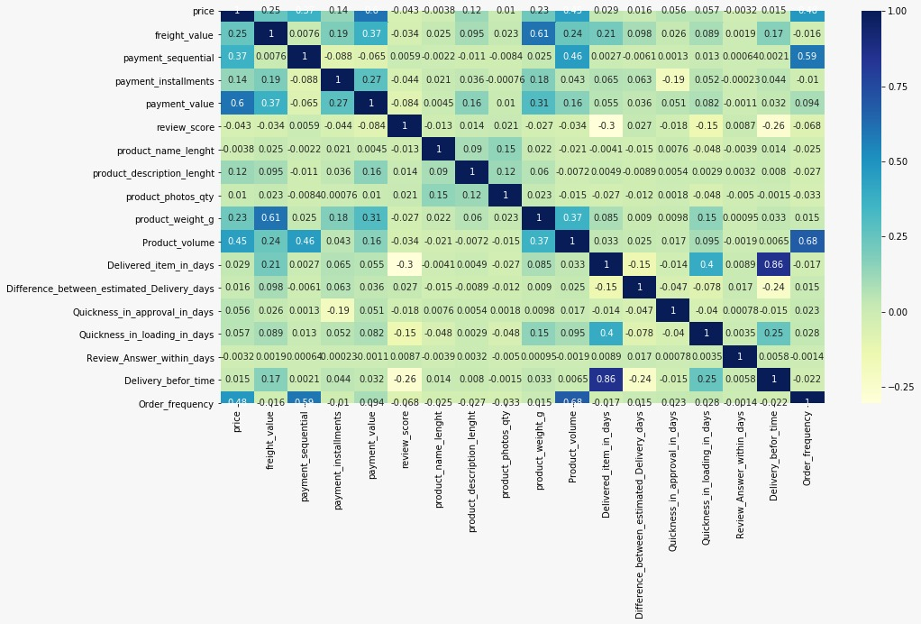

Slide 28
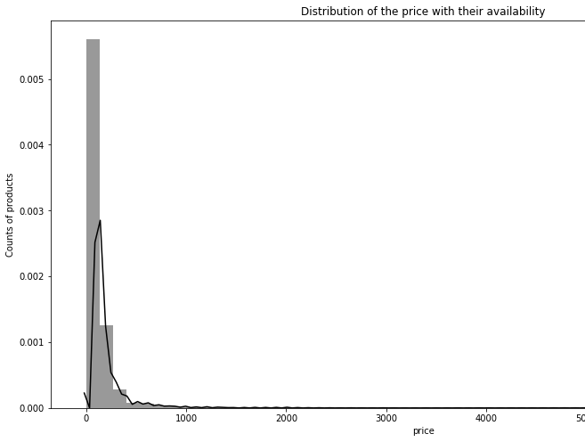
We see that, the products of low price are exist in the market in a huge amount, which means people are buying these products only. Let us discuss this further for unique product and its frequency with respect to the customers.

Slide 29
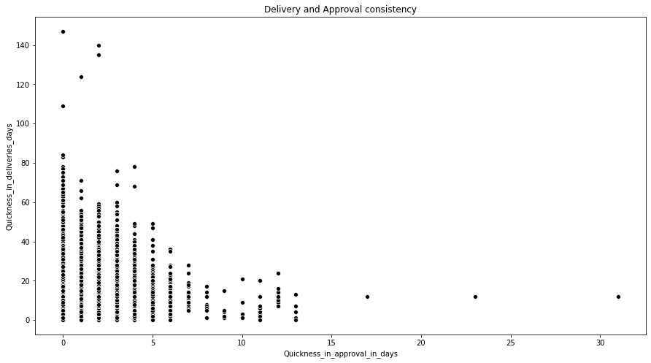
For many orders, we can see that, service approved the order at the same day, but delivery took place after several days.
We can see there are some orders, which were approved so late, but delivered so quickly.
For many orders, the order was quite soon approved, but delivery got very much late.

Slide 30
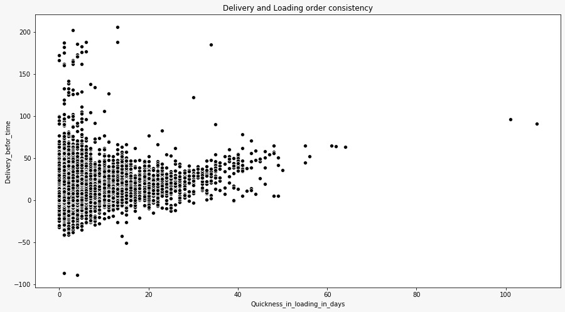
We can see that there not more orders delivered before time, the proportion of the delivery late is more than that of earlier.
Service company should think of it very curiously, this can affect the customer churn.

Slide 31
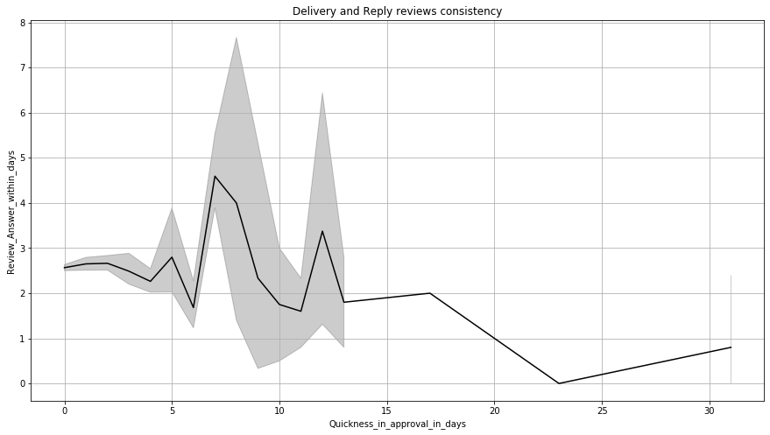
Here we can observe there are huge numbers of datapoints in the range of (0,14) & (0, 7.8).
The thing we found from the data is, no matter how many days it takes to approve customers' orders, the review is quite late.
We see that, there are many customers, who got their approval before 15 days, and company answered their review maximum by 8 days, in comparison to the approval time, review response is quite faster.

Slide 32
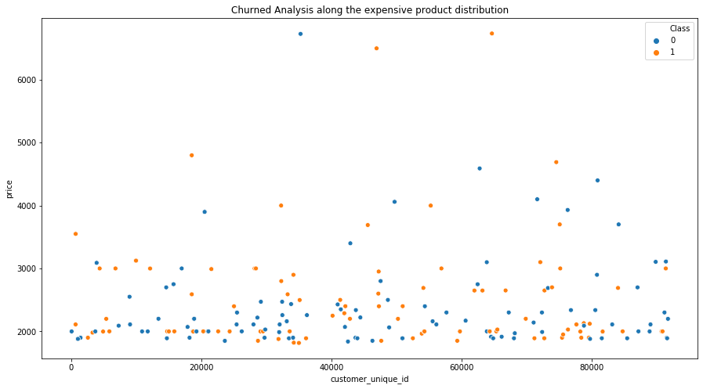

Slide 33
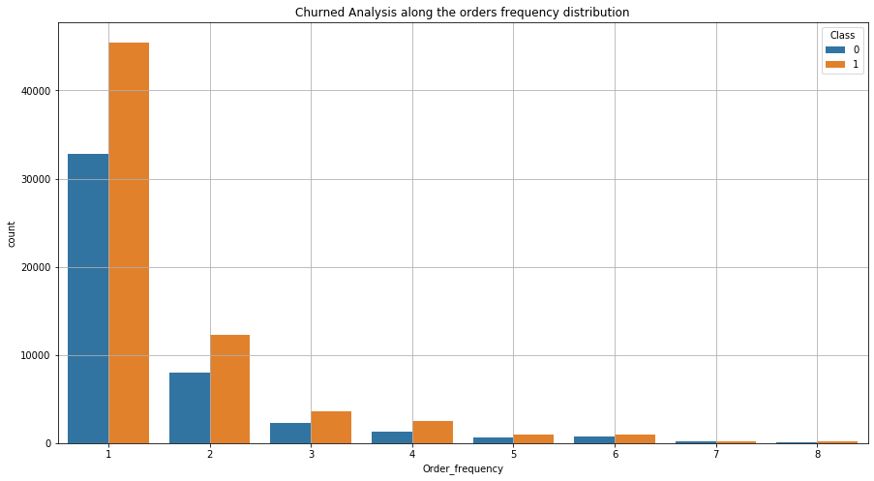

Slide 34
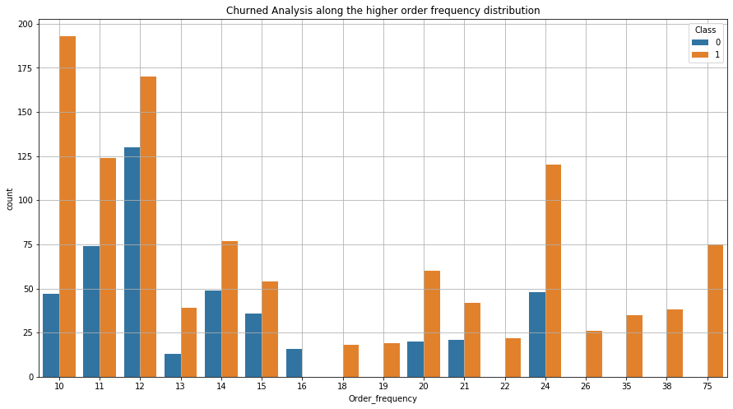

Slide 35
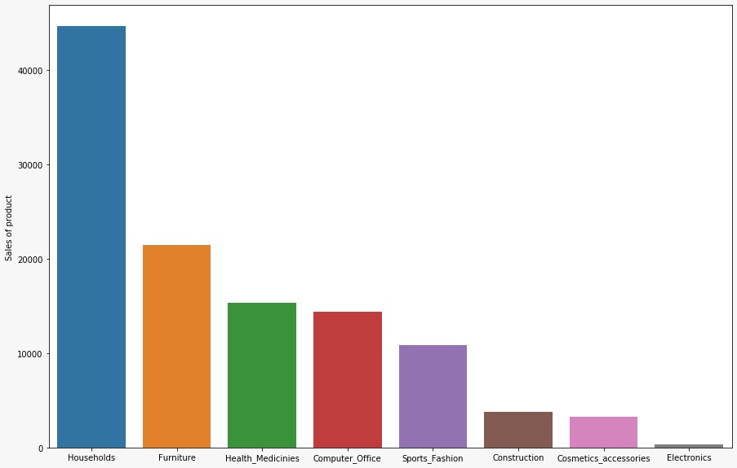

Slide 36
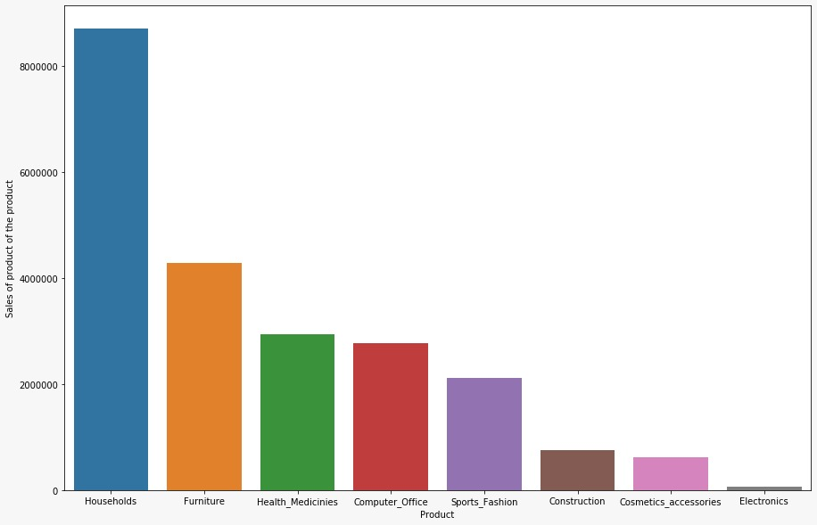

Slide 37
Insights from the Plots
We see the count of customers are very high who ordered only two products from the service. Which seems they are ordering by two things Occasionally Any electronic product which is casually ordered by its long damage only.
From next plot we sincerely observed that order frequency by 1 is very high from the service. Which means that the customers are mostly ordering only one product.
There are many customers left the service who were ordering the products in a very lesser amount. We have given the cause of the scenario above.
Most of the people churned the service who were the daily customers. This could be affecting the business, which will cause in future. Cause may be orders in time. If the order takes huge time they could be uncomfortable with it, remaining regular customer will leave service does not make any sense.
From Stack bar plots we have got a clear analysis that, the rate of churn all the frequencies is quite larger than that of rate of non-churn.

Slide 38
How should company manage this order frequency scenario?
Company should offer them a good offer so that, they could purchase more than one product at a time, by which the order frequency will increase.
The customers buying occasionally with low frequency, company should offer them some household products with reasonable price, if their count doesn't improve, then no benefit to entertain them. If they leave company does not suffer any huge difference.
By messaging or call, attract those customers who are regular in ordering, get the knowledge of their leaving of the service. And increase the staff to place the order on the time. This could remain them connected.
Company should think of the reason of such scenario of high-rate churn all along the business.

Slide 39
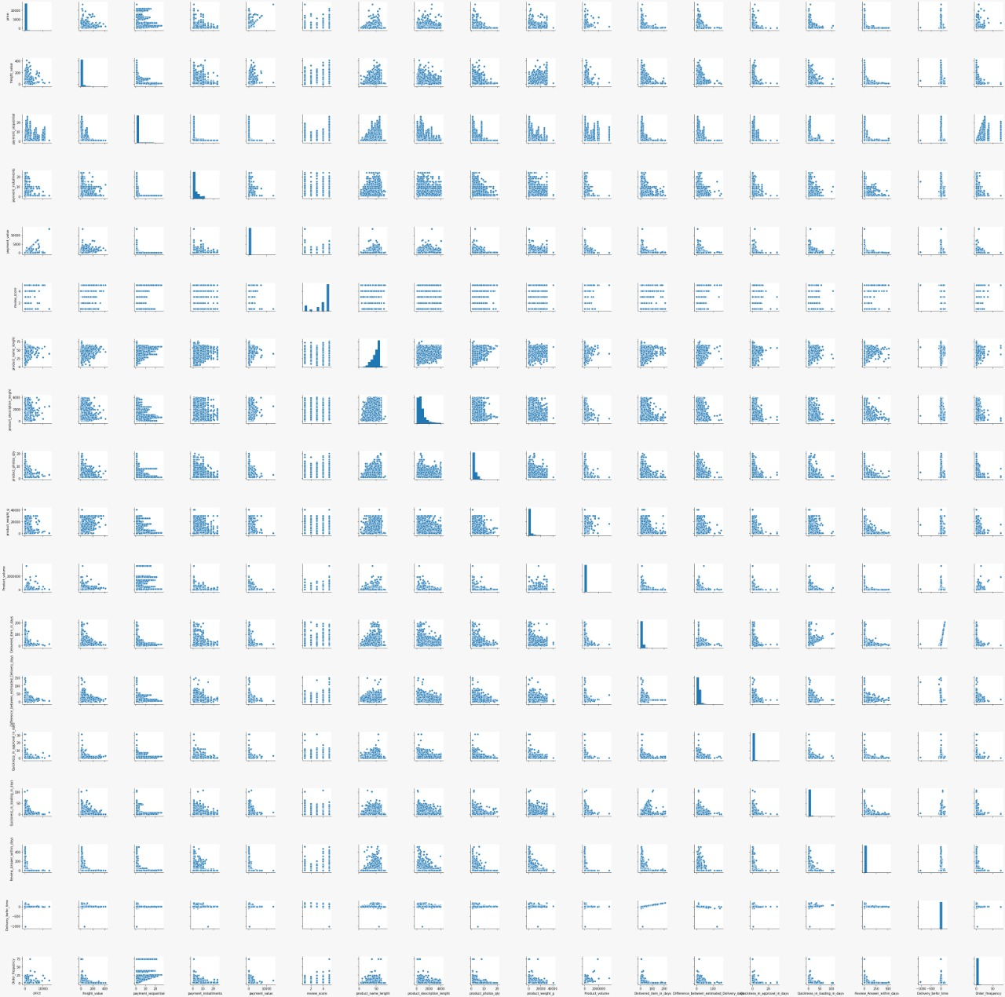

Slide 40
Statistical Analysis
Index | Feature1 | Feature2 | Significance
1 | Quickness_in_approval_in_days | Quickness_in_loading_in_days | Significant relation
2 | price | product | Significant relation
3 | Order_frequency | Class | Significant relation
4 | Difference_between_estimated_Delivery_days | order_status | Significant relation
5 | order_status | Class | Insignificant relation
6 | product_Cosmetics_accessories | product_Households | Significant relation
7 | price | Order_frequency | Significant relation
8 | product_description_lenght | review_score | Significant relation
9 | price | Product_volume | Significant relation
10 | price | Freight_value | Significant relation
11 | Freight_value | Product_volume | Significant relation

Slide 41
Insights from the Statistical Tests
There is a significant change difference between approval time to the loading time.
There is indeed no specific relation in Product and Price. Price is dependent on the product for some cases.
There is indeed a specific relation in Customer consistency and Order frequency. The customers are ordering consistently they are either leaving the service or strongly stayed to the service.
There is indeed a specific relation in Order delivery consistency and status of the order. For sure if the delivery gets earlier customers become happy with the services. They remain consistent with the service.
There is no significant relation between order status and customer consistency. Which means if the order does not get approved by the customer, this does not lead to leave the service. But this scenario does not make sense for each circumstances.
Customers purchasing households can attract towards the cosmetics accessories as well. Which means buyers are ladies for household stuffs. We can give them like cosmetic discount to increase the customers count. We have done so much Visualizations to prove this.
Higher the price of products affect the frequency of orders.
People from the area are not keen in shopping. Company should bestow them greatest offers.
May be discount can be given to the customers who have a higher frequency in the order.
There is an effect of description on reviews. Company should give the good description of the product to the customers. Elaborate the product very well.
Price of the product depends upon the size for some cases like households or clothes and fashions. For some cases this is not related especially for the Electronic Devices. Hence, we can claim that most of the things in the service are available on household products. We also proved this in Visualizations.
There is an affect of size and price on freight value. Some products are of lesser size with high expense can affect the freight value and vice versa.

Slide 42
Machine Learning Algorithms
As our problem statement is of Binary Classification. We can leverage the following classification algorithms
Logistic Regression
Naïve Bayes
K-Nearest Neighbour
Decision Tree
Ensemble Techniques

Slide 43
Accuracy of Models
Index | Model | Train accuracy | Test accuracy
1 | Logistic Regression | 0.654663 | 0.656
2 | Naive Bayes | 0.431277 | 0.431867
3 | Decision Tree | 1 | 0.808783
4 | Decision Tree Tuned | 0.806487 | 0.791451
5 | KNN | 0.739994 | 0.595152
6 | Stacking | 0.788677 | 0.777812
7 | Bagging | 0.822372 | 0.805091
8 | Random Forest | 1 | 0.82946
9 | Random Forest Tuned | 0.77159 | 0.756266
10 | Adaptive Boosting | 0.99929 | 0.822336
11 | Gradient Boosting | 0.787504 | 0.782373
12 | Extra Trees | 1 | 0.719517
13 | Extra Trees Tuned | 0.591891 | 0.590852

Slide 44
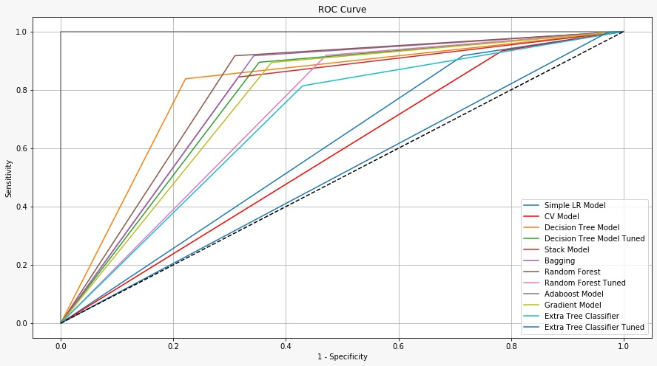
ROC Curve
LR model : 0.6014208677552341
LR CV model : 0.5749177927357321
Decision Tree model : 0.8081465496822055
Decision Tree model Tuned : 0.7712017539
Stack model : 0.7641534351665751
Bagging : 0.7896083901177469
Random Forest : 0.8078773519189124
Random Forest Tuned : 0.7176639153719
AdaBoost model : 1.0
Gradient model : 0.759712519682044
Extra Trees Classifier : 0.6992541336996998
Extra Trees Classifier Tuned : 0.51004182775529

Slide 45
Data Source
https://www.kaggle.com/olistbr/brazilian-ecommerce

